Slide 1
HOME AUTOMATION
With Nodemcu ESP8266
Using Blynk and Google Assistant

Slide 2
Index
Aim of Project
Introduction
Hardware Components
Hardware Implementation
Coding Description
Advantages
Drawbacks
Conclusion
Reference

Slide 3
Aim of Project
To make a smart home.
Connecting electronic appliances to internet.
Control electronic appliances over the internet and control them manually also.
Using Blynk app to control home appliances.
Connecting the home appliance to the google assistant via IFTTT platform.
Using sensors to get home conditions.

Slide 4
Introduction
With advancement of Technology in all aspects life is getting simpler and easier.
Every year usage of internet has increased rapidly across the world, which makes life more easier.
With the help of internet everything is interlinked and every device is connected to internet.
Each and every electronic appliance in home can be controlled by using internet.
The process of getting things over internet is called as “Internet of Things” IOT.

Slide 5
Hardware Components
Nodemcu ESP8266
4 Channel Relay Board
IR sensor
Alarm
Push Buttons
Jumpers
Bulbs
Sockets
Battery
Personal computer(For coding ESP8266)
USB cable

Slide 6
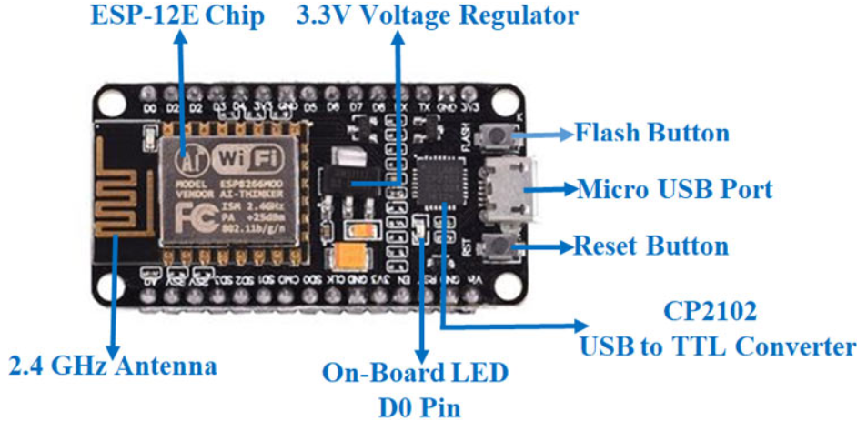
Nodemcu ESP8266
Microcontroller: Tensilica 32-bit RISC CPU Xtensa LX106
Operating Voltage :3.3V
Input Voltage :7-12v
Digital I/O Pins : 16
Analog Input Pins : 1
Flash Memory : 4 MB
SRAM : 64KB
Clock Speed : 80MHz
PCB Antenna

Slide 7
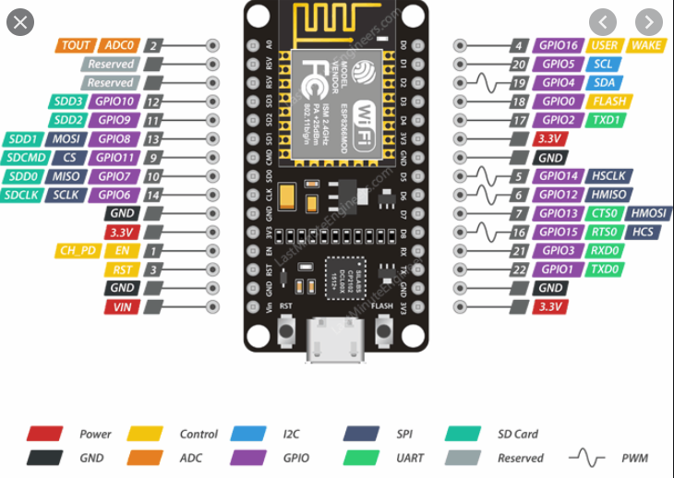
Nodemcu ESP8266
Applications of Nodemcu:
Prototyping of IoT devices
Low power battery operated applications
Network projects
Projects requiring multiple I/O interfaces with Wi-Fi and Bluetooth functionalities

Slide 8
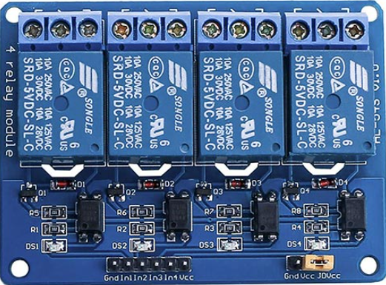
4 Channel Relay board
The 4 Channel Relay Module is a convenient board which can be used to control high voltage, high current load such as motor, solenoid valves, lamps and AC load. It is designed to interface with microcontroller such as Arduino, PIC and etc. The relays terminal (COM, NO and NC) is being brought out with screw terminal. It also comes with a LED to indicate the status of relay.
Rated through-current: 10A (NO) 5A (NC)

Slide 9
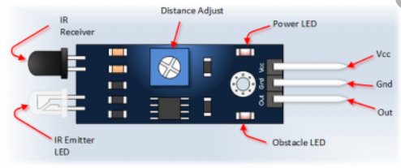
IR sensor
IR sensor is used to detect the objects at a distance
It consists of two leds one acts as transmitter and other acts as a receiver.
The white one will acts a emitter and emits IR wave.
The black one will receive the IR rays that are reflected by the objects
Based on that rays it will define the object distance.

Slide 10
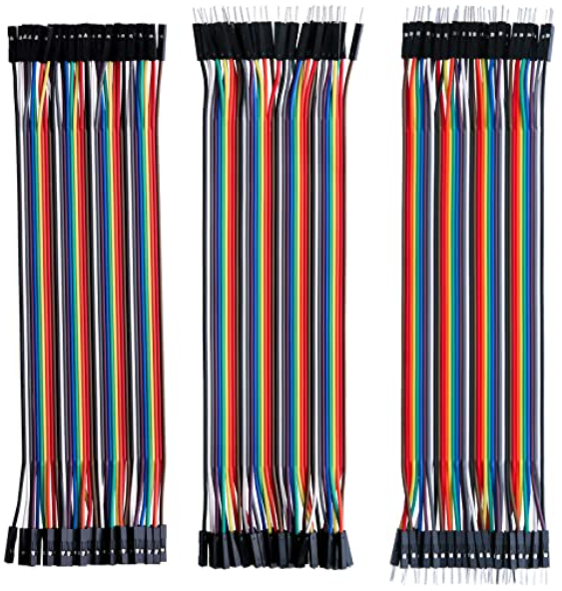

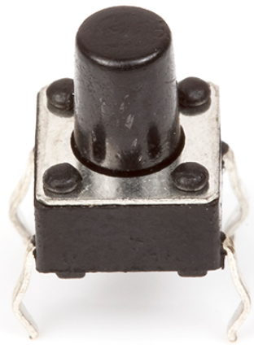

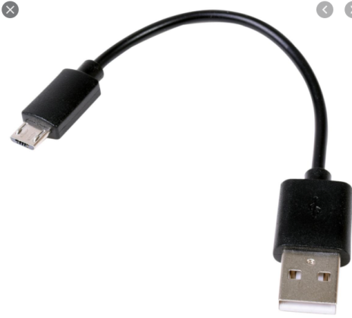
Other Hardware components
Jumpers
Push Buttons
9v Battery
Bulbs
USB cable

Slide 11
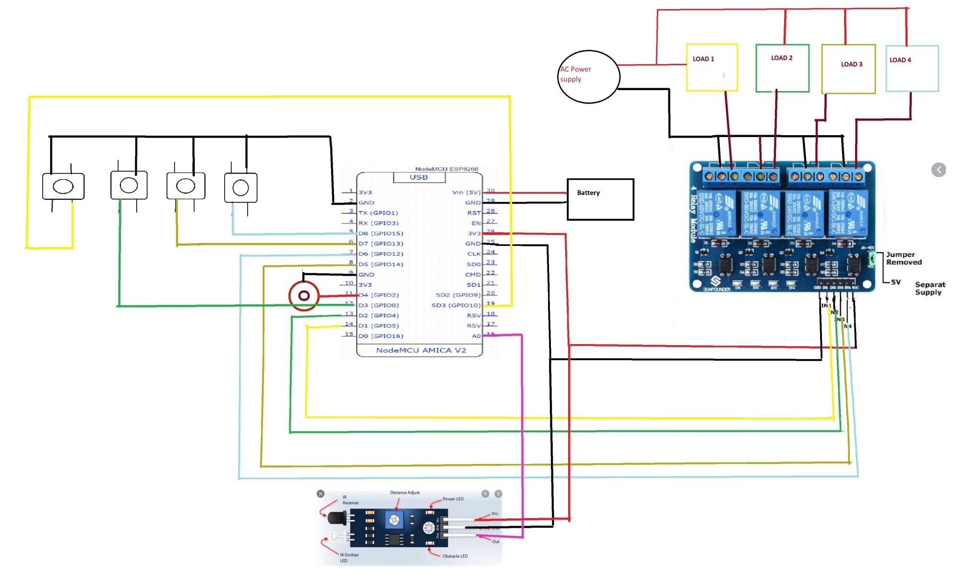
Hardware Implementation

Slide 12
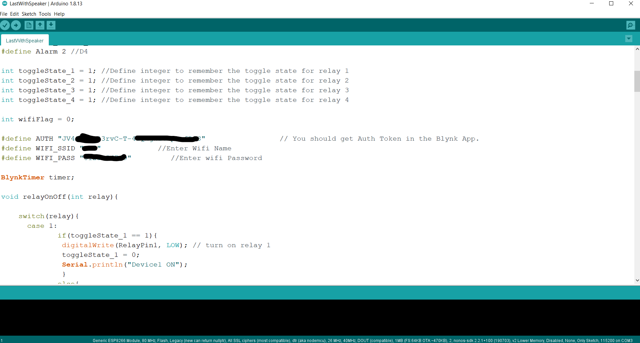
Coding Description
Download Ardunio software in your computer.
Download ESP8266 board in Ardunio software.
Connect the ESP8266 microcontroller to computer using USB cable.
Select the COM port and Upload the code with your WIFI details and other requirements
While uploading the code click on flash button on ESP8266.

Slide 13
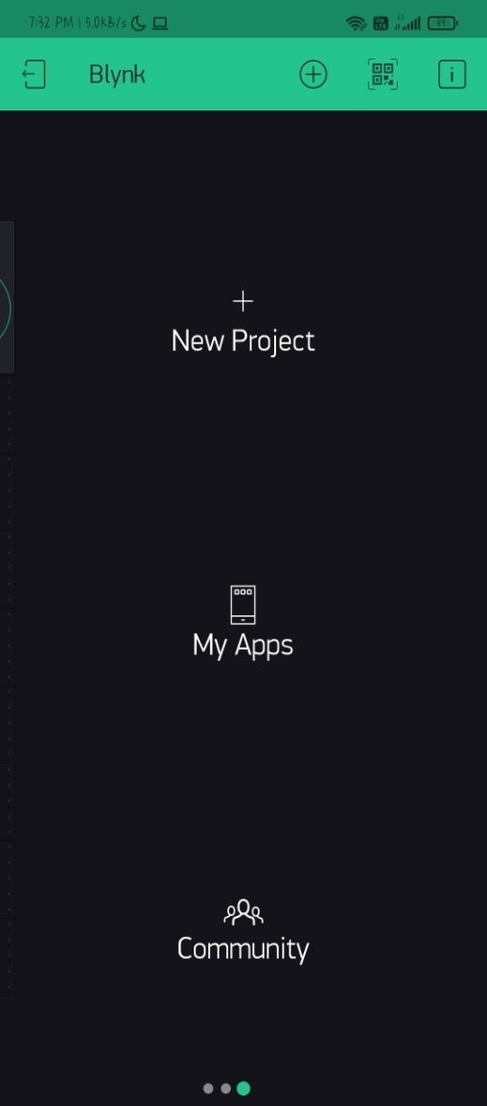
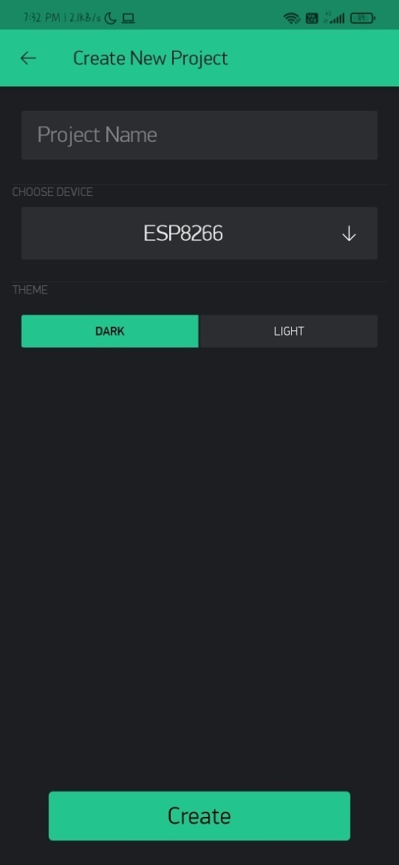
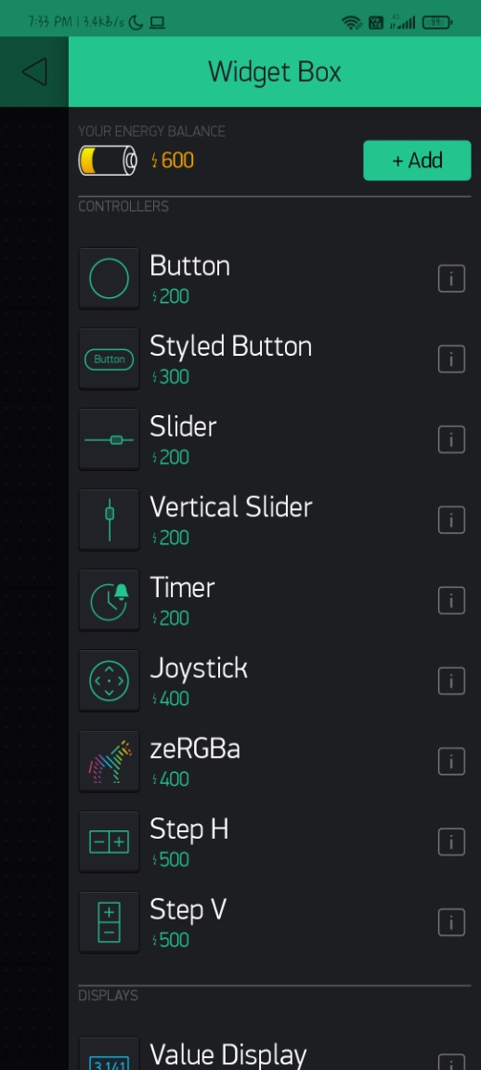
Blynk app setup

Slide 14
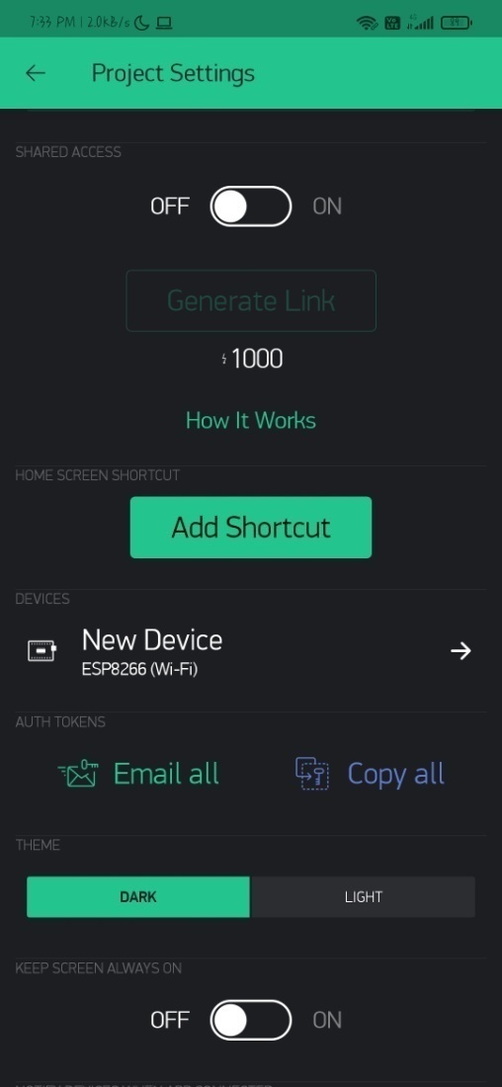
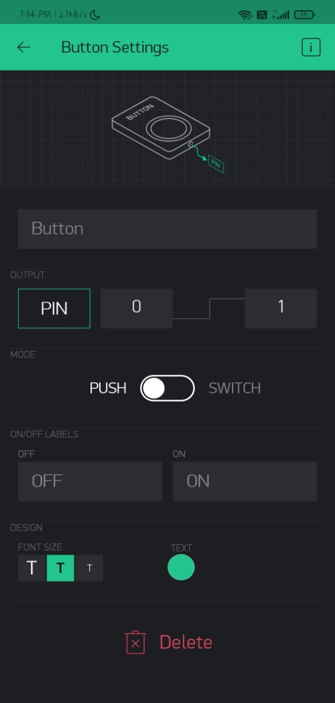
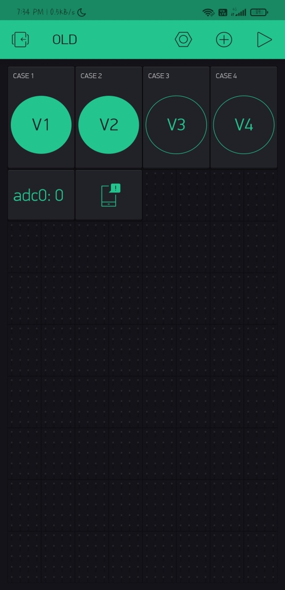

Slide 15
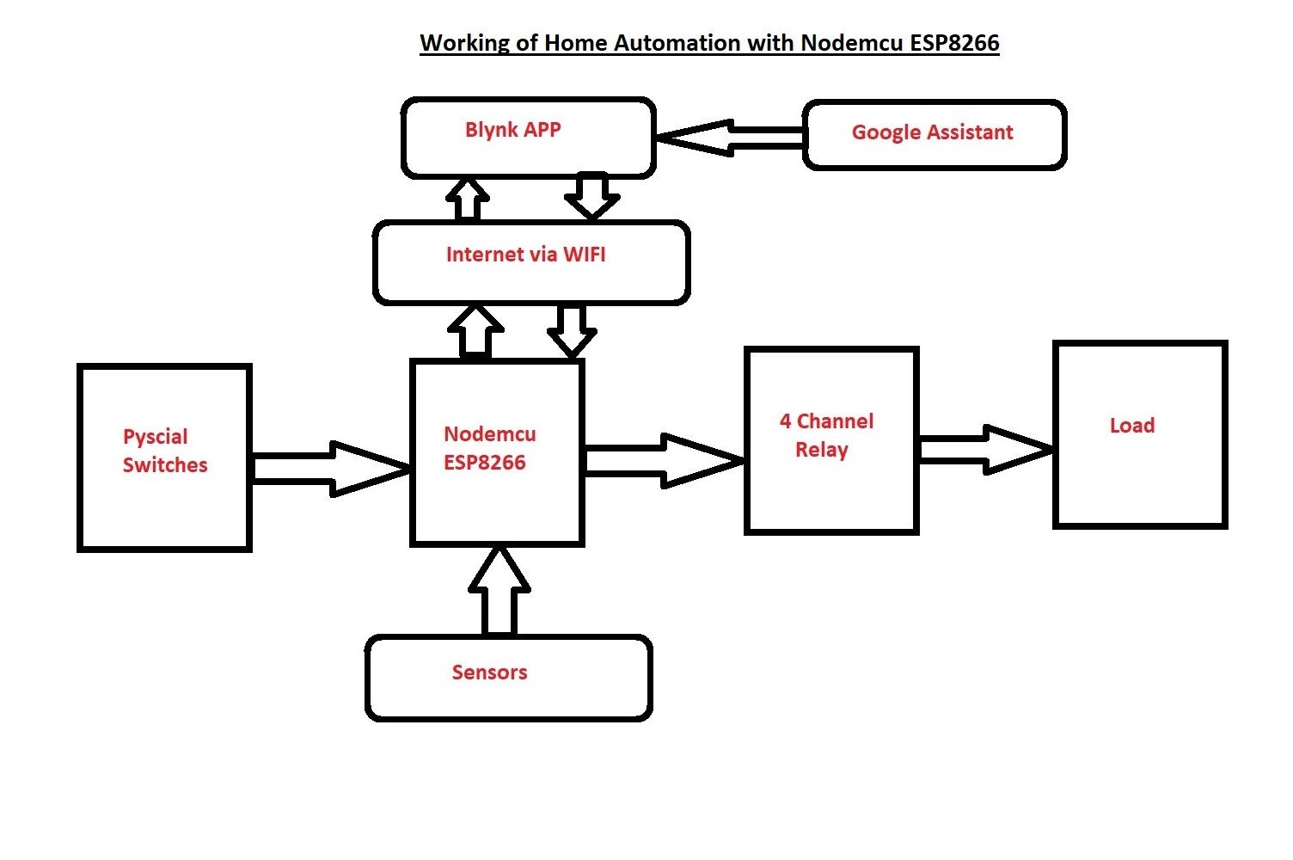
Working of Project Outline

Slide 16
Advantages
Drawbacks
Easy to control home appliances
Can be controlled from any part of the world with real time feedback.
Can be controlled manually without internet
Helps to reduce power usage
Security can be increased
Continue monitoring can be done
Everything gets OFF after restart.
Security concerns
Vulnerable to attacks
Sometime operations can be restricted to time

Slide 17
Conclusion
From this project we can control home appliance via internet with real time feedback.
If there is no internet we can control it manually.
Project can work with Google Assistant i.e works with voice commands.
Can be controlled from all over the world if internet is present.

Slide 18
References
https://www.youtube.com/watch?v=Jc6Jet1Yqsk
https://iotcircuithub.com/nodemcu-esp8266-blynk-home-automation/
https://www.arduino.cc/en/software
https://create.arduino.cc/projecthub/Raushancpr/arduino-with-ir-sensor-1579b6
http://kth.diva-portal.org/smash/get/diva2:679674/FULLTEXT01.pdf
https://randomnerdtutorials.com/how-to-install-esp8266-board-arduino-ide/
https://components101.com/development-boards/nodemcu-esp8266-pinout-features-and-datasheet#:~:text=The%20NodeMCU%20ESP8266%20development%20board,to%20store%20data%20and%20programs.

Slide 19
THANK YOU
Project by:
Ram sai(18AK1A0471)
Sai Tharun(18AK1A0479)
Satish(18AK1A084)

